Slide 1
1- Khaled Dia (20164726) 2- Majd Abu Nimeh (20166086) 3- Amin Abdullah Mahmoud Aqel (20166756) 4- Abdelrahman Mahmoud A.Mahmoud (20167318) 5-Ahmed Ali Abdelazim (20185942) 6-Asem Abdou (20193554) Instructor: Assist. Prof. Dr. Parvaneh Esmaili
Emergency Backup System For a critical load

Slide 2

Project Outline
Introduction
The main Source and the ATS
Cooling System
Backup Generators
Load balancing and synchronization
Safety Circuits and system Connections
Remote Control and Control Panel
Refrences

Slide 3

Introduction
When there is a sudden failure in the power supplied to any facility, we would find ourselves in a need of emergency backup system that is powered by diesel standby generators.
like in hospitals that need to be 24 hours supplying electricity as the oxygen needs to be flowing to the patients in every second.
In our project we developed a complete system to simulate the process of having backup generators working alongside with the main source
We used MATLAB, Simulink, MATLAB application designer, Other programming and markup languages like HTML, CSS, and JavaScript
Our system can be controlled using a control panel that was designed by the MATLAB application designer.
And can be controlled using a remote control via internet link from a web page.

Slide 4
Introduction
Our system is supplied by three synchronous diesel-powered generators with 600 kW power generation as a backup system.
The critical load for the system requires 500 KW
In case the mains have failed, the generators shall supply, the power to the load and distribute the load among themselves.
In case one or more of the generators fails or become operational again, the working generators shall redo the load balancing.
When the grid network power becomes available, the generators shall stop.
All the generators should operate synchronously.
Every 8 hours, one of the generators should stop and cools the machine.

Slide 5

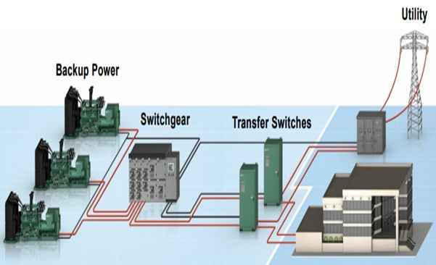
Backup System Overview

Slide 6

Next: We will start showing our system

Slide 7
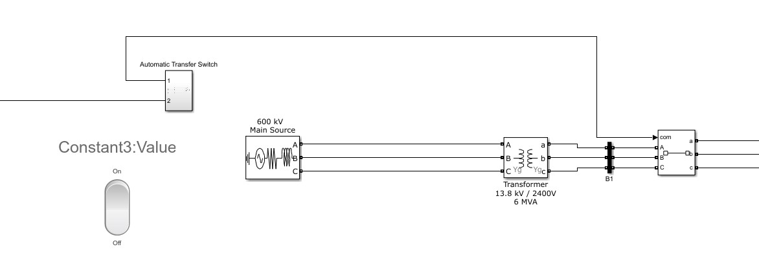
The main source and the ATS

Slide 8
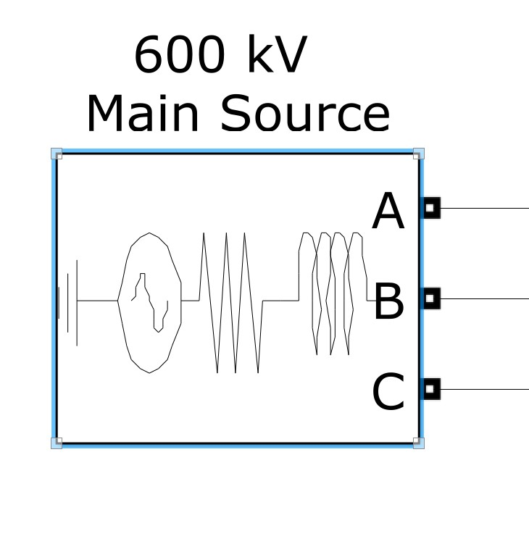
Main Source Block

Slide 9
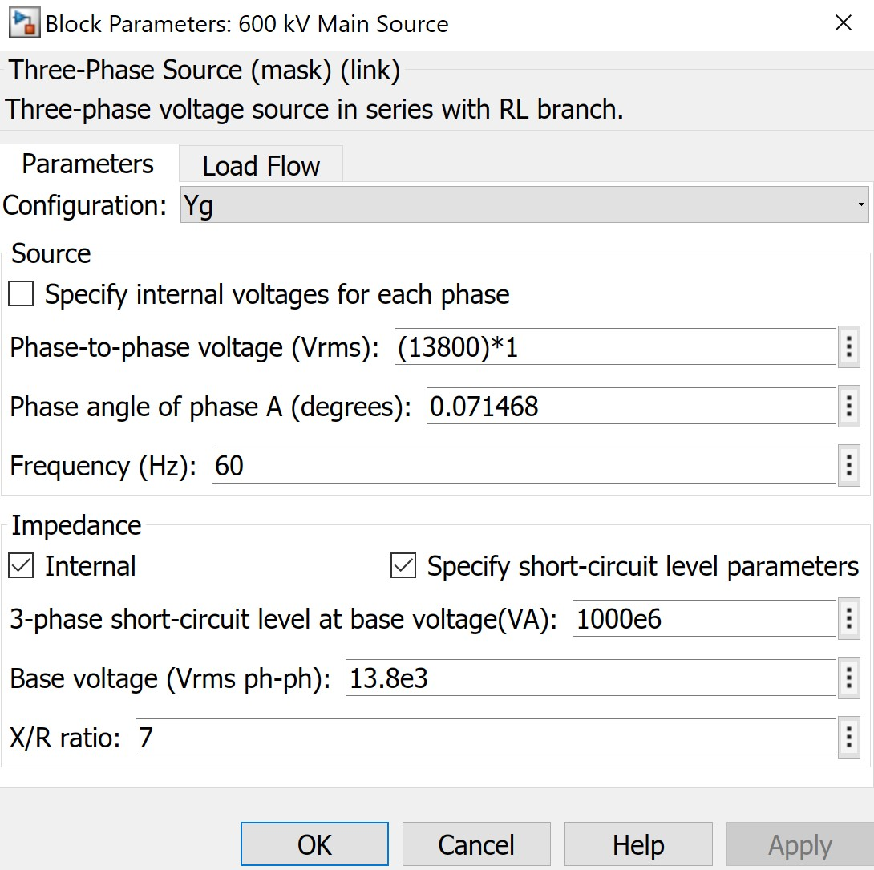
Main Source Parameters

Slide 10
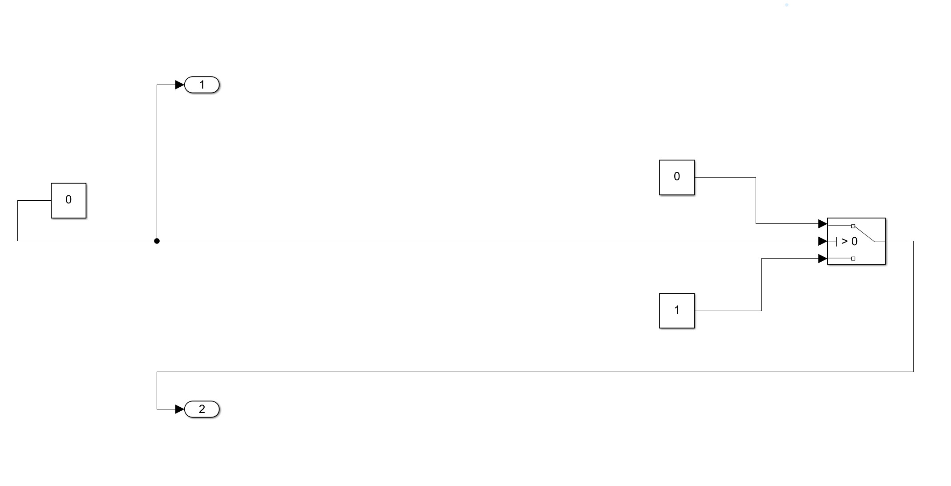
Automatic Transfer Switch

Slide 11
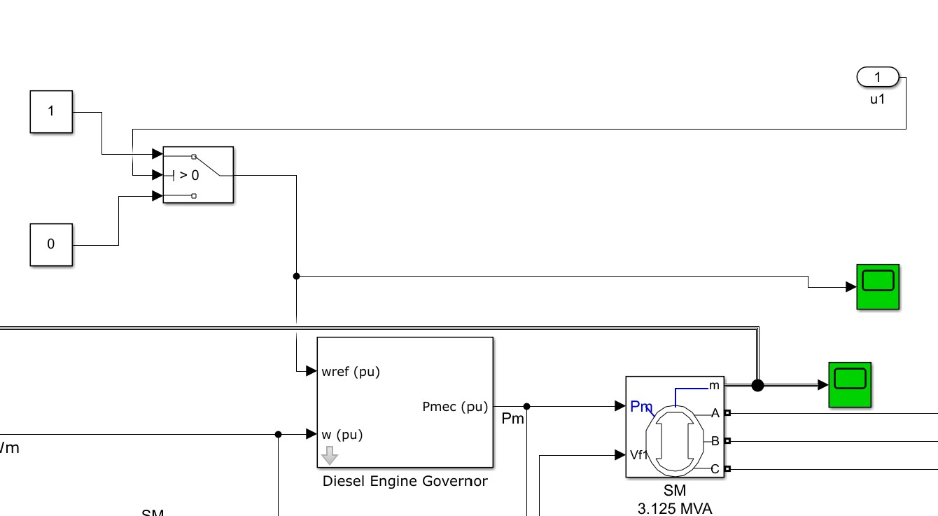
ATS to Generators

Slide 12
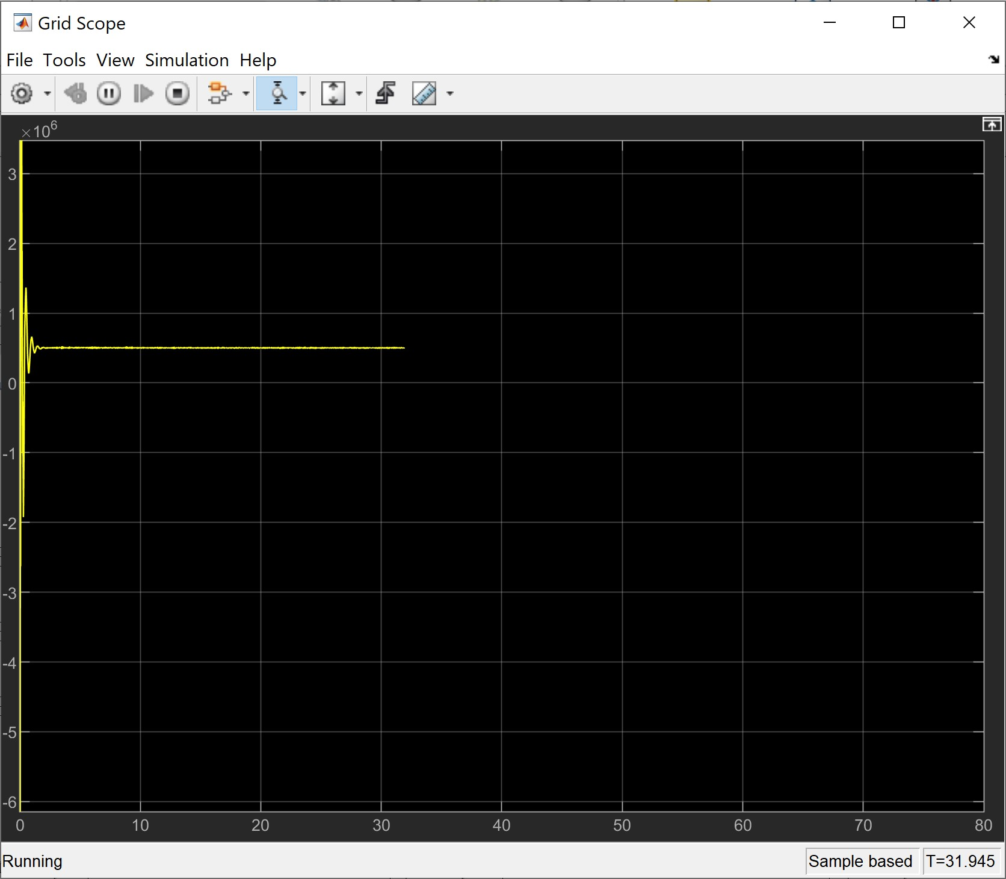
Grid is on

Slide 13
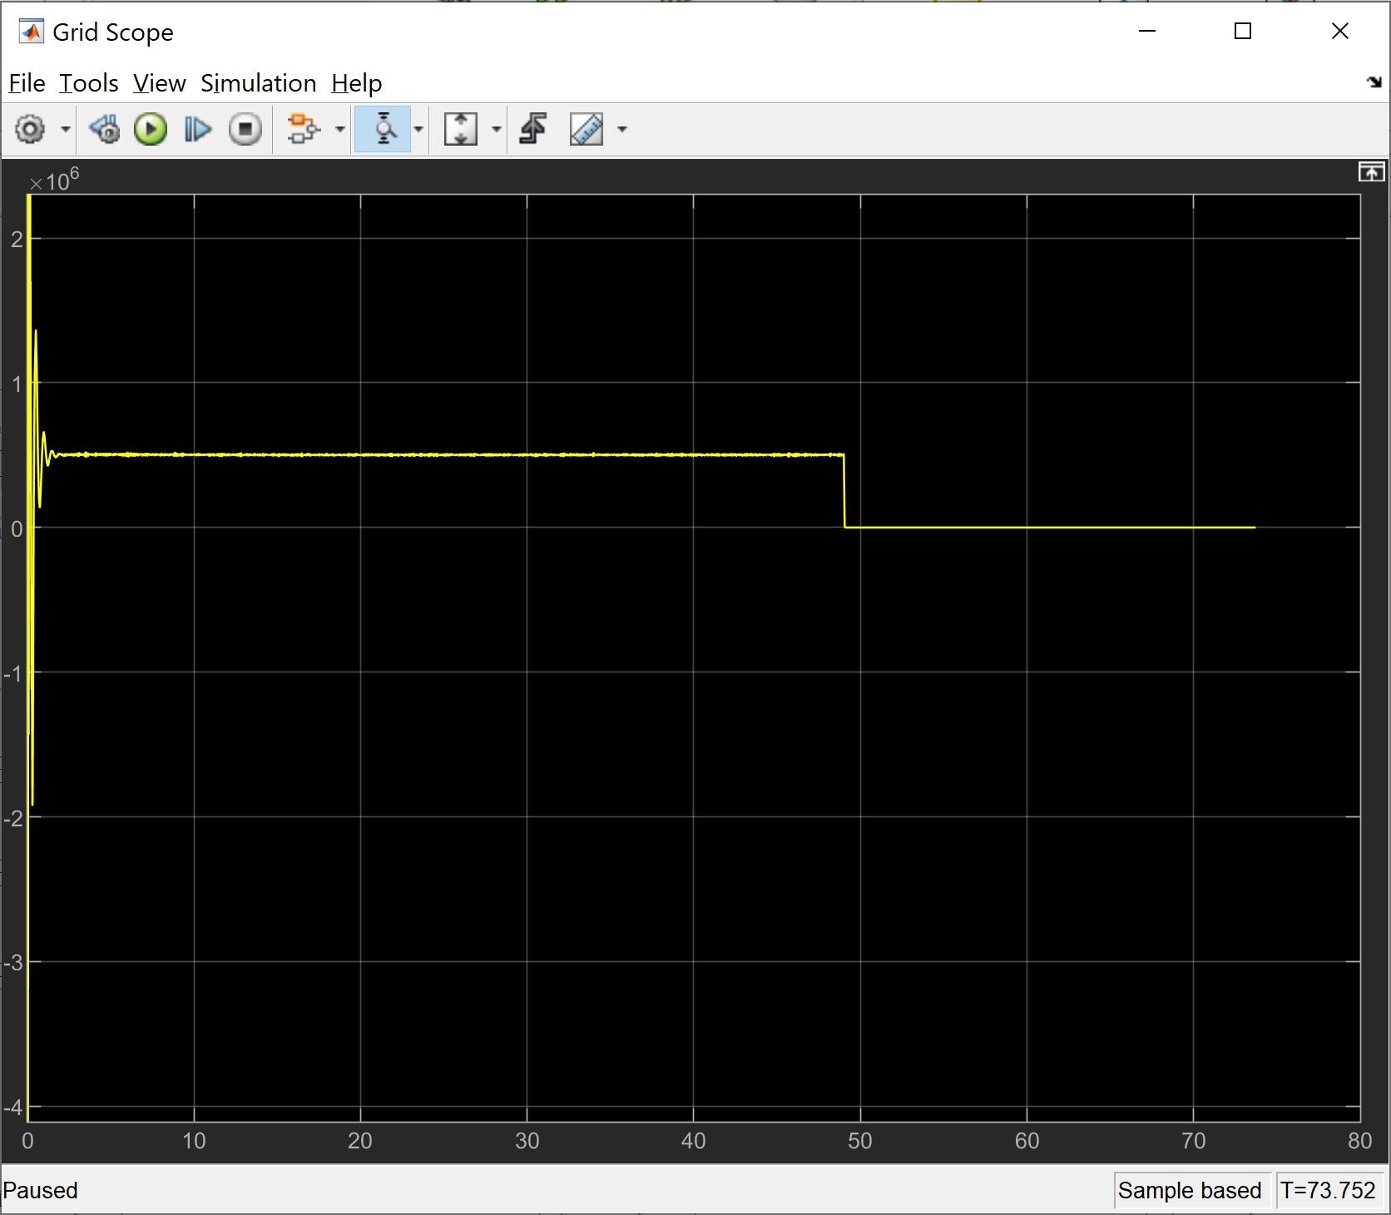
Grid Switched off

Slide 14
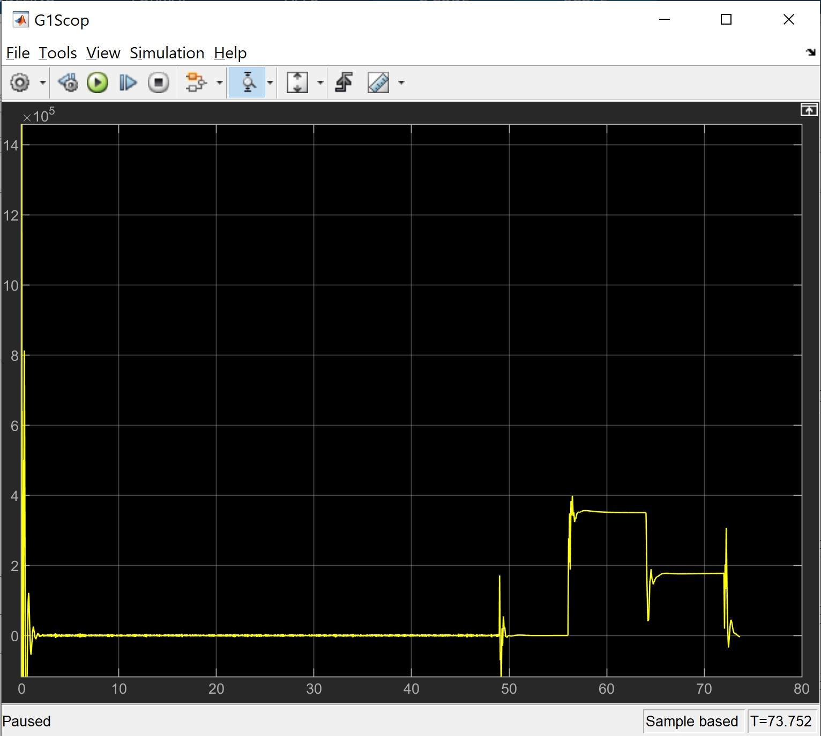
Generators Becomes Operational

Slide 15
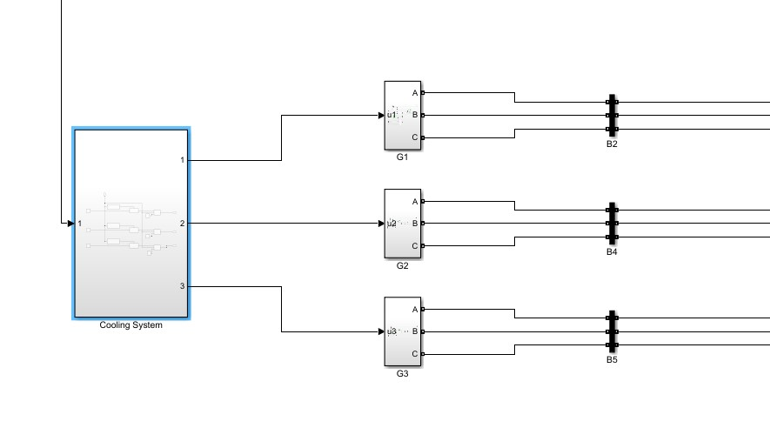
Cooling System

Slide 16
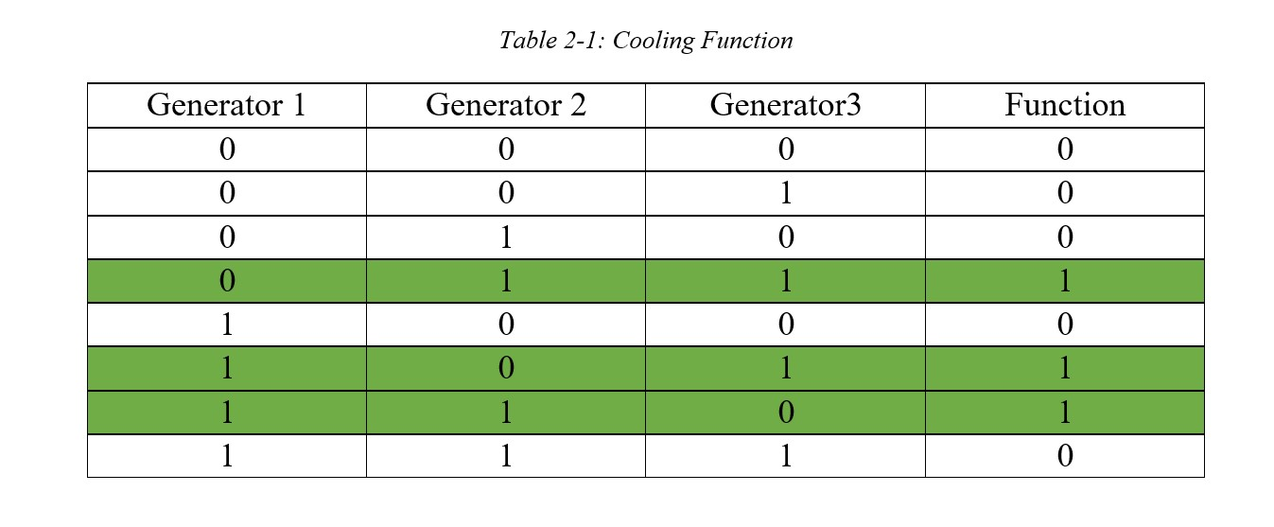
Cooling Logic System

Slide 17
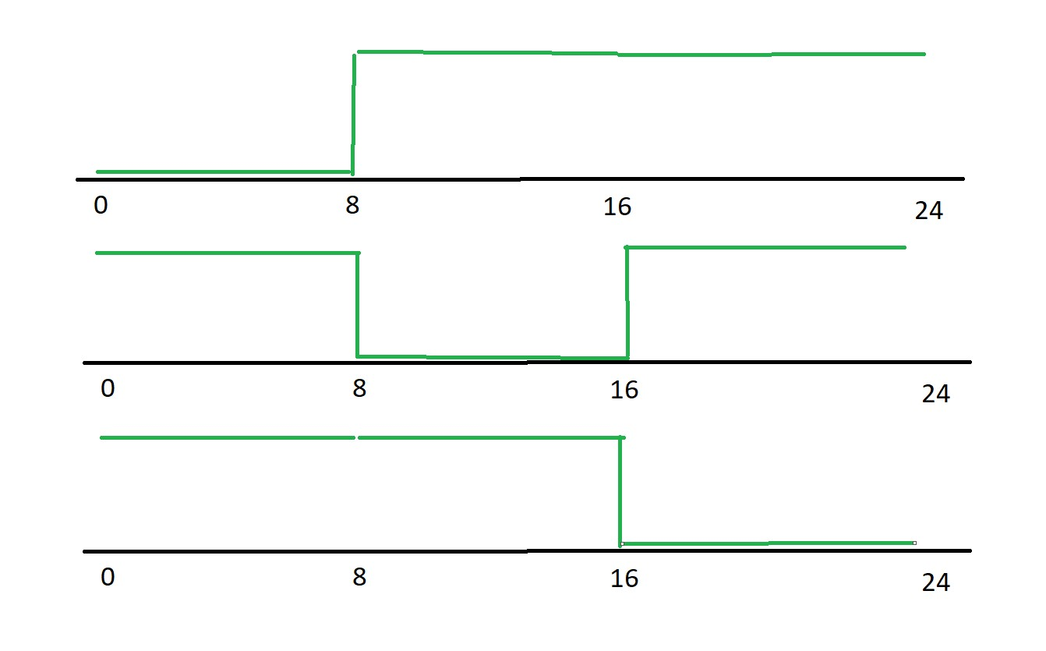
Clock Waves

Slide 18
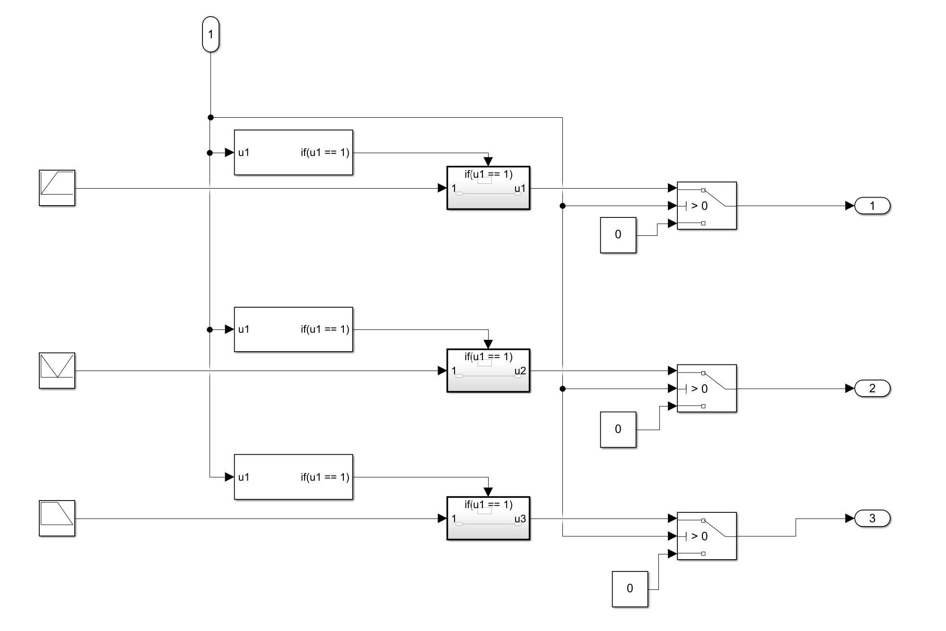
Building Blocks
Repeating Sequence
If Condition
If Action Subsystem
Ideal Switch
Zero as Constant

Slide 19

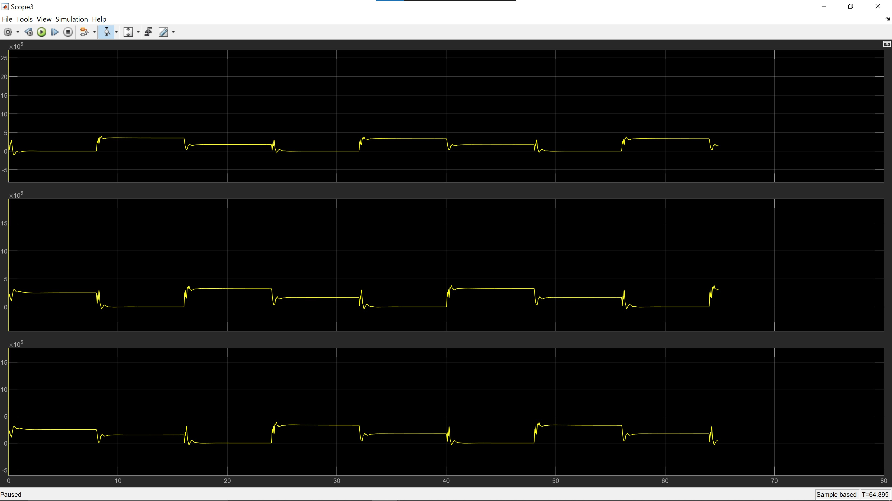

Results
Operational Events For Generators

Slide 20
Backup Generators

Slide 21
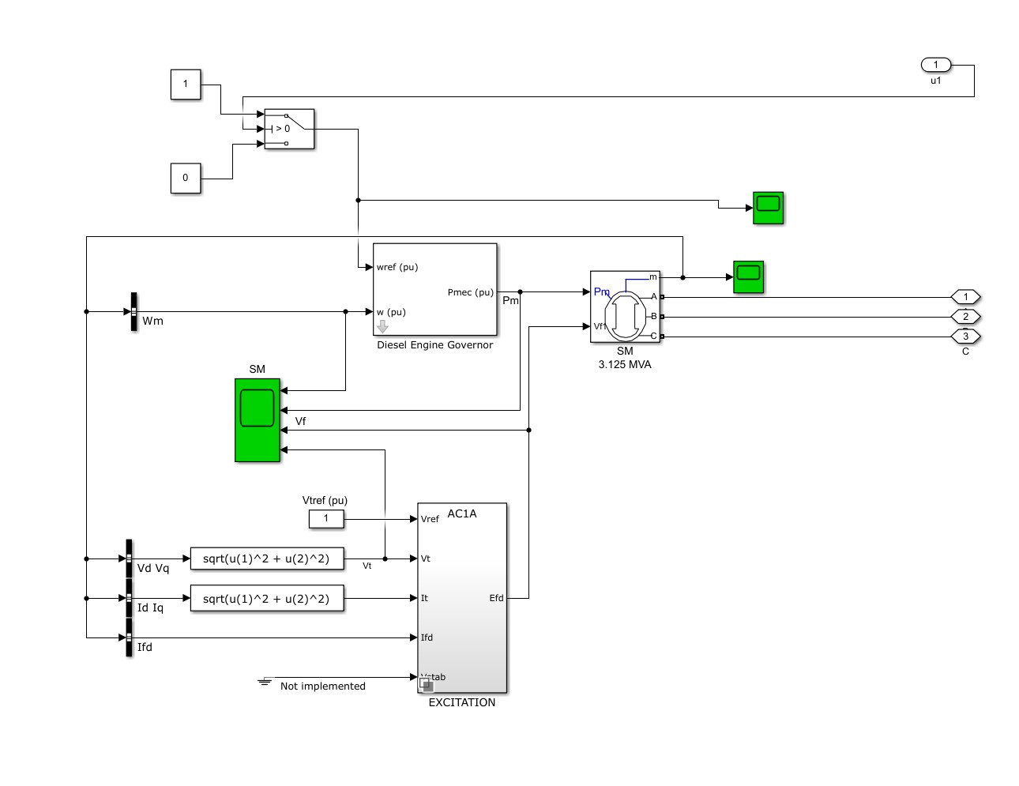
Generator Components

Slide 22
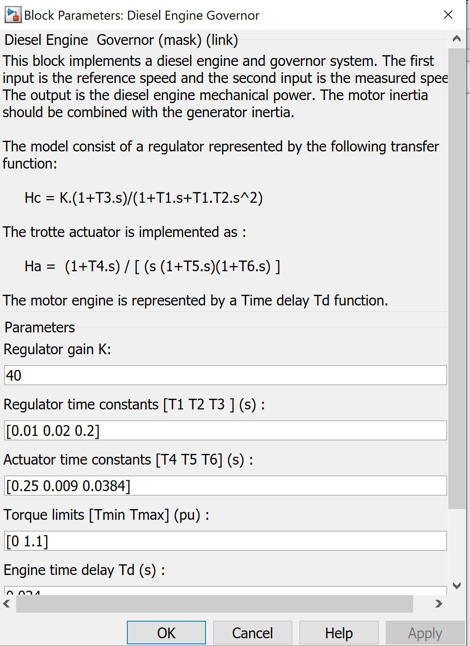
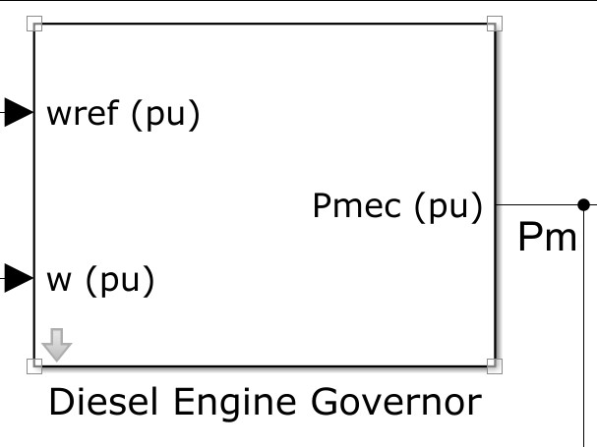
Diesel Engine Governor

Slide 23
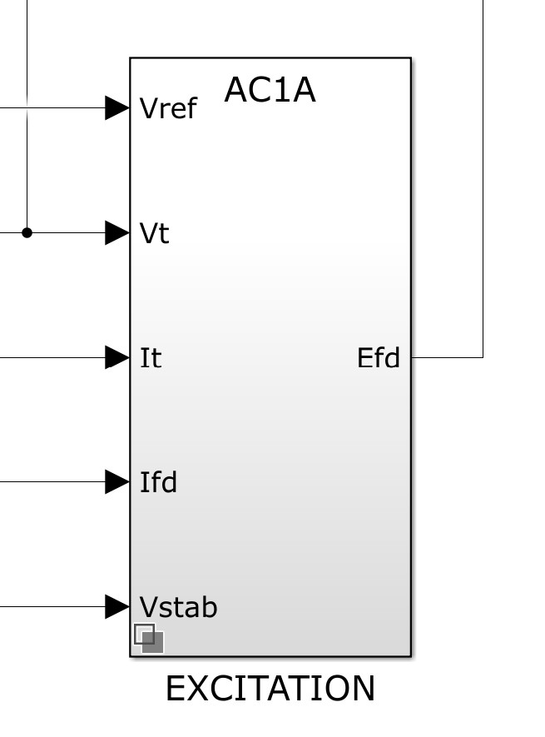
Excitation Block

Slide 24
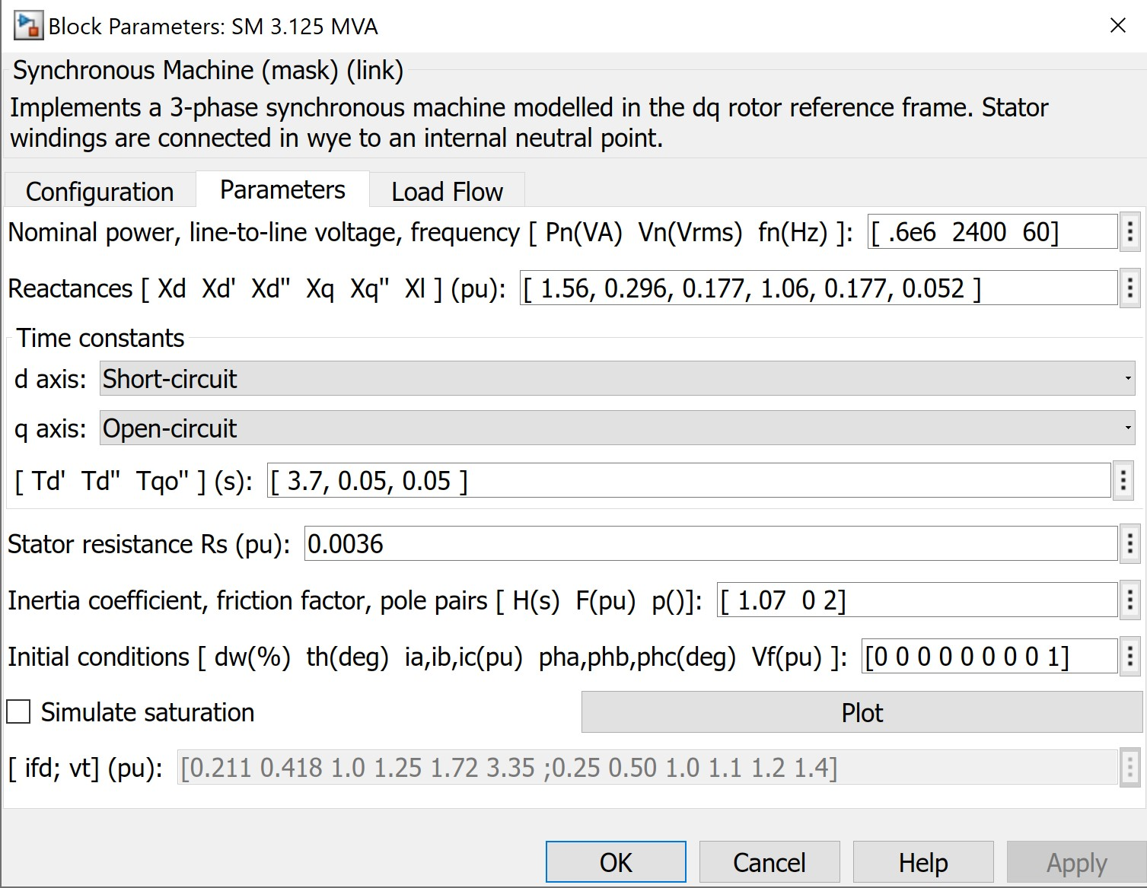
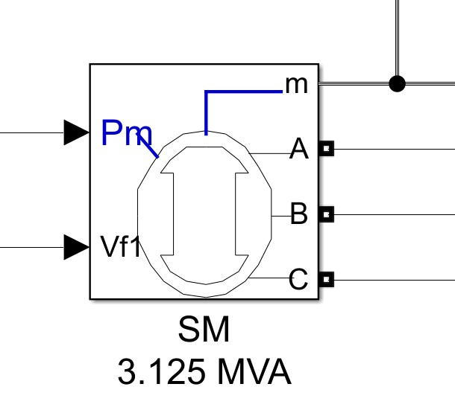
Synchronous Machine

Slide 25
Balancing and Synchronization
The Generators and load Balancing
Load Block and its values
The method used to Balance the generators and the load
Three Dark Lamps Method
The Waveform and Figure

Slide 26
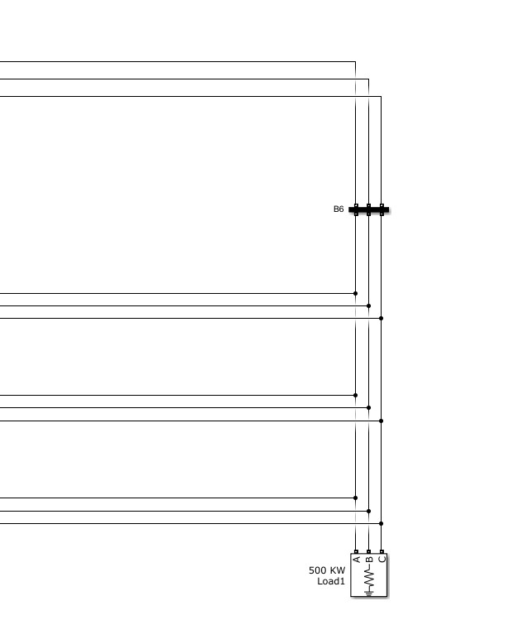
Load Balancing and Synchronization

Slide 27
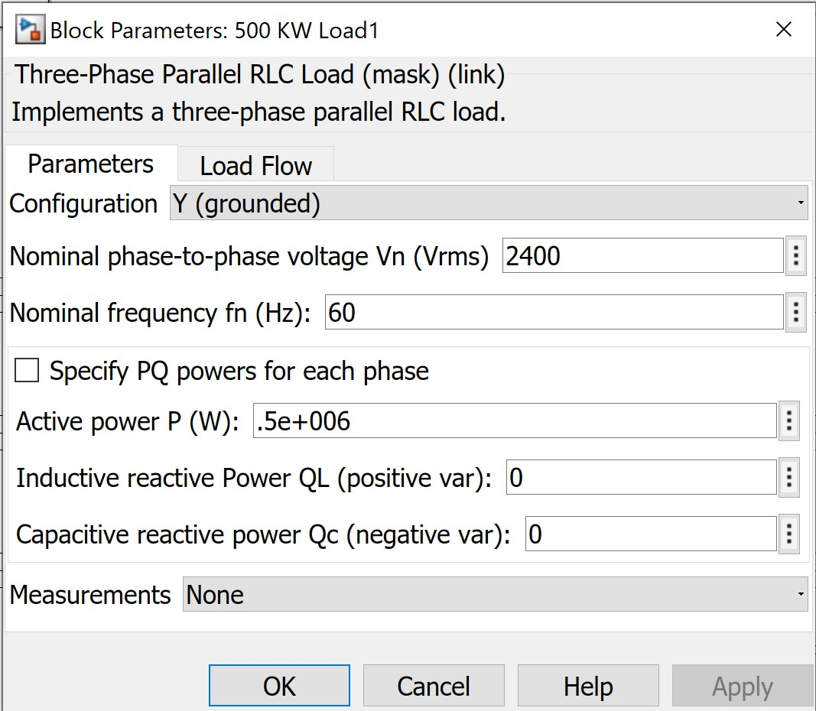
Load BLock

Slide 28
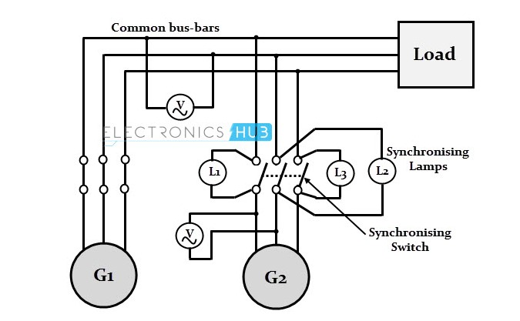
Three Dark Lamps Method

Slide 29
Balancing and Sycnhronization

Slide 30
Safety Circuits and Power Connections
Transformer
Circuit Breaker
Bus Bars: to output the voltages and currents in per unit values or in volts and amperes
Measurements System

Slide 31
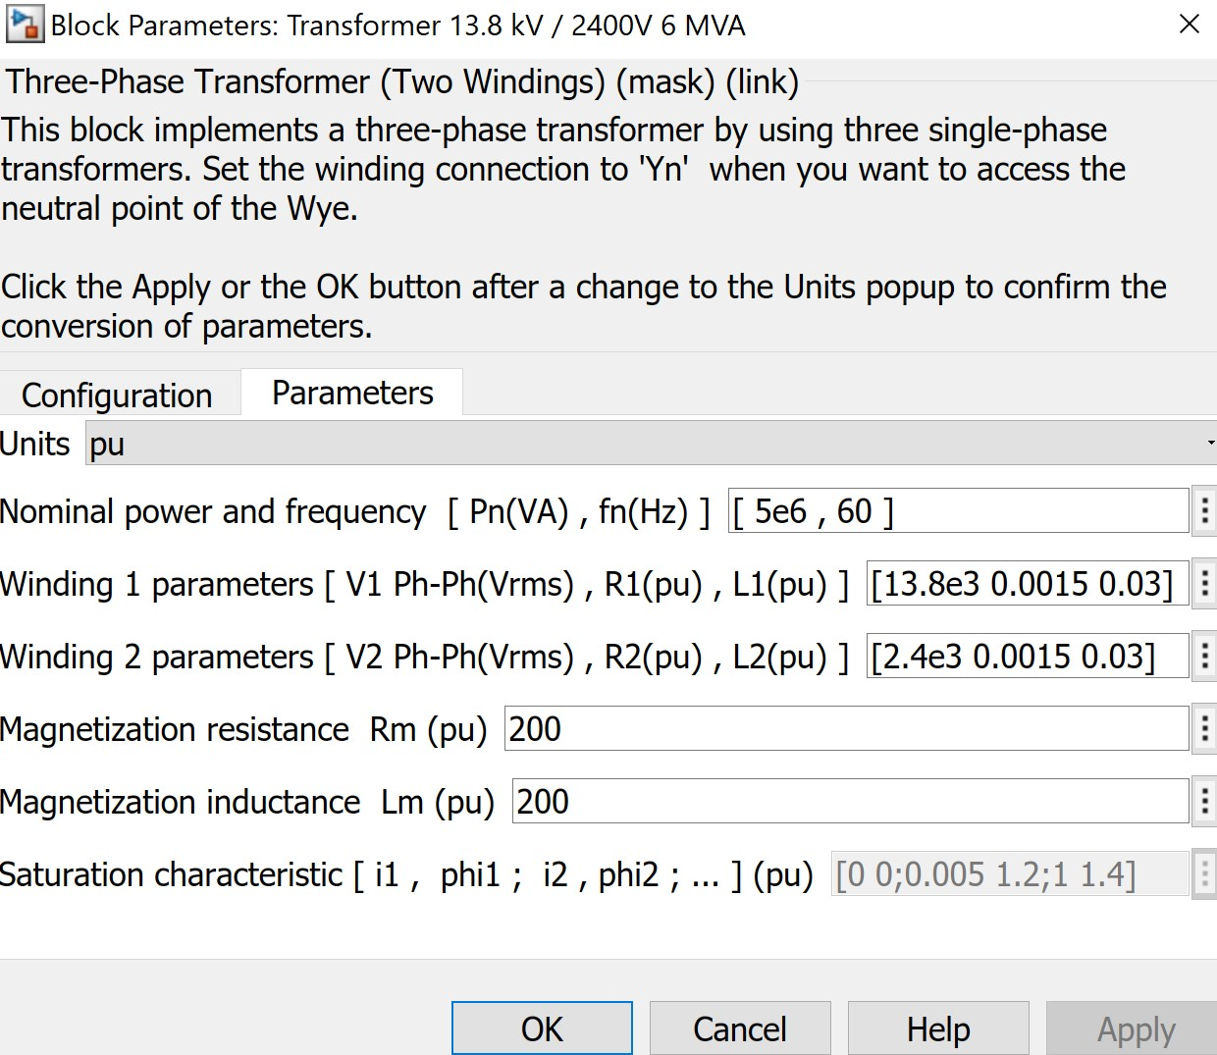
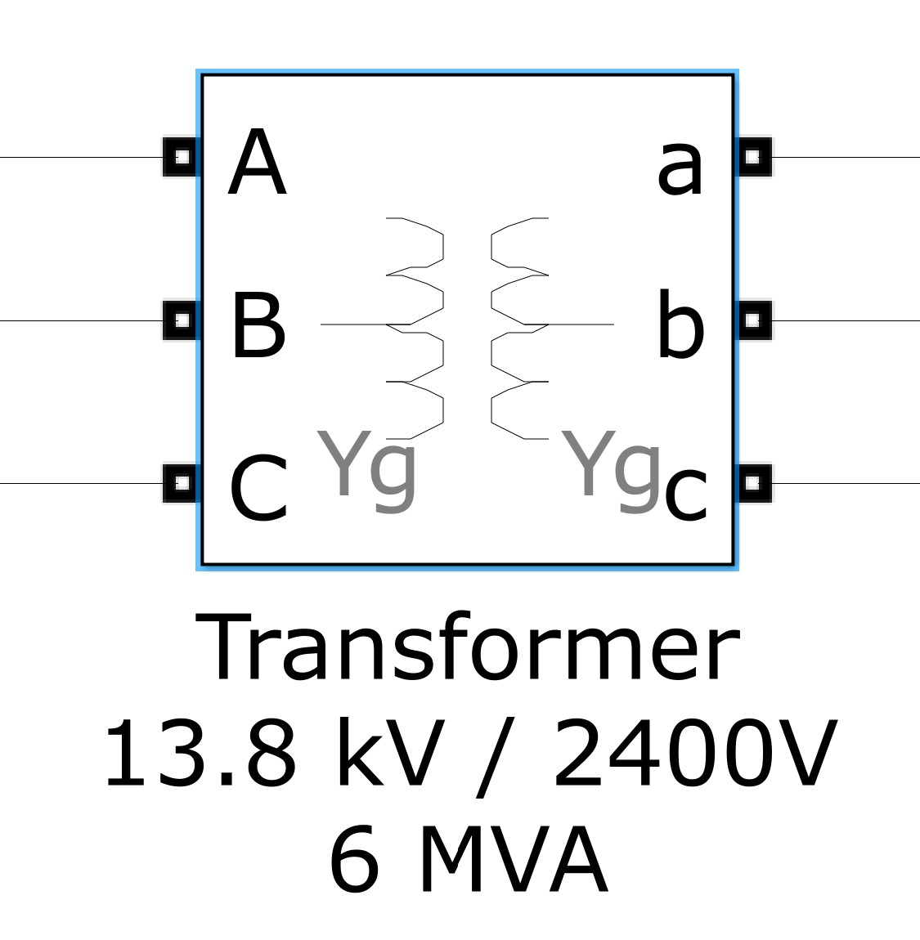
Transformer

Slide 32
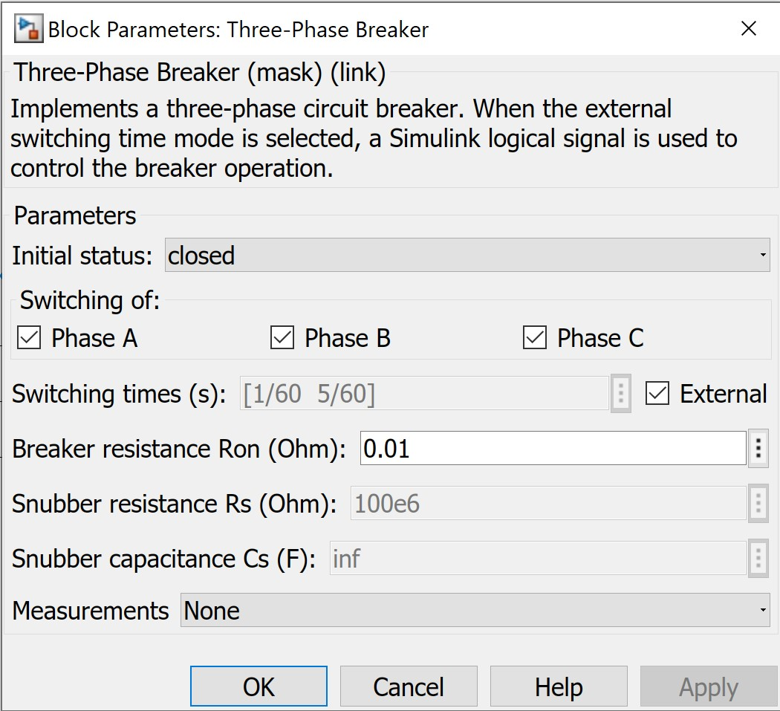
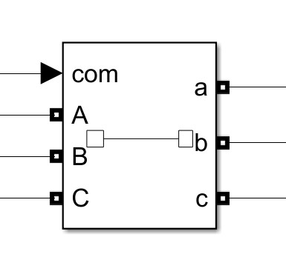
Circuit Breaker

Slide 33
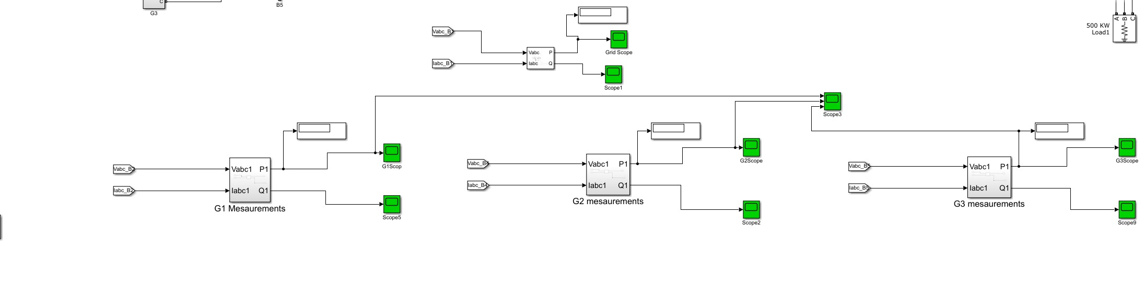
Measurements

Slide 34
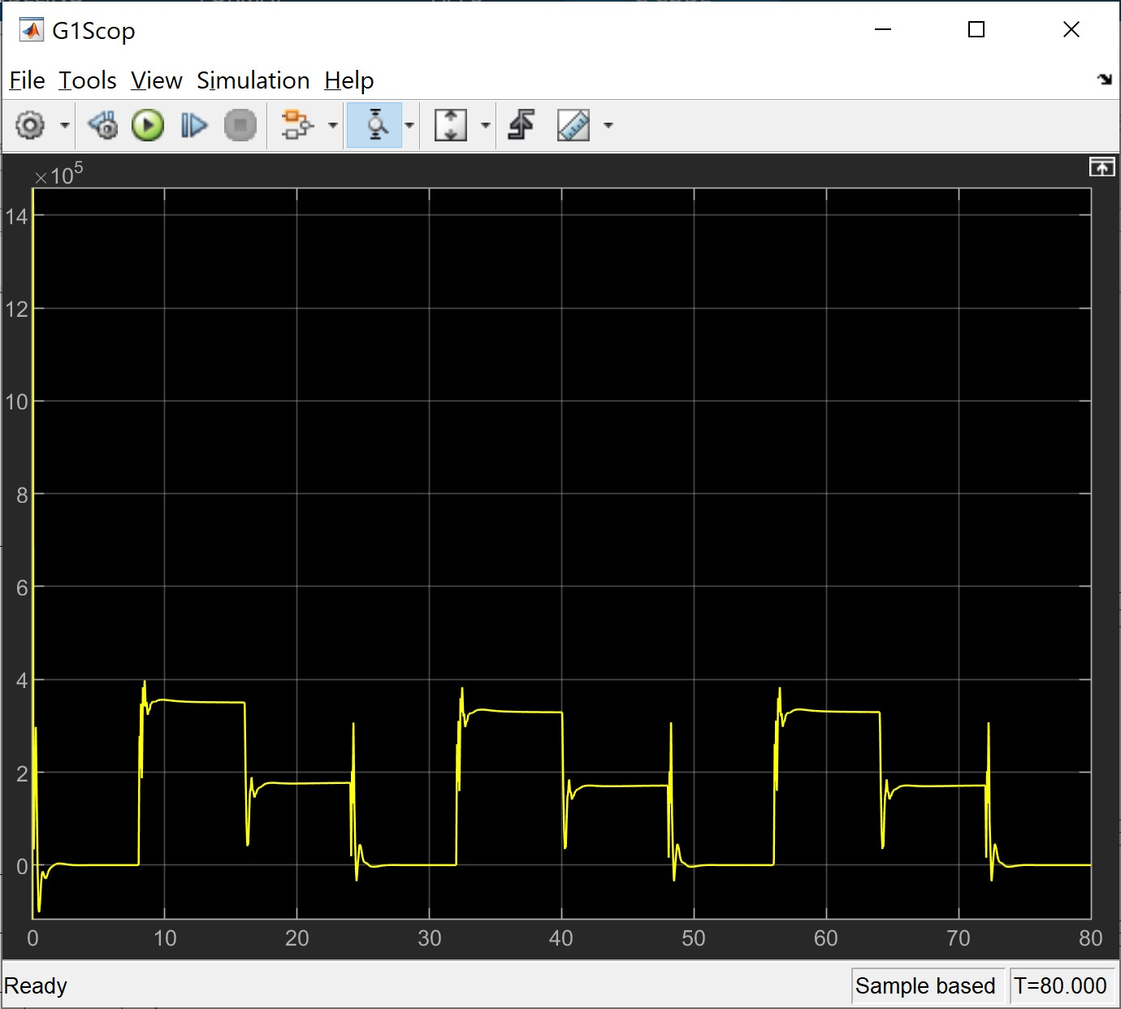
Generator 1

Slide 35
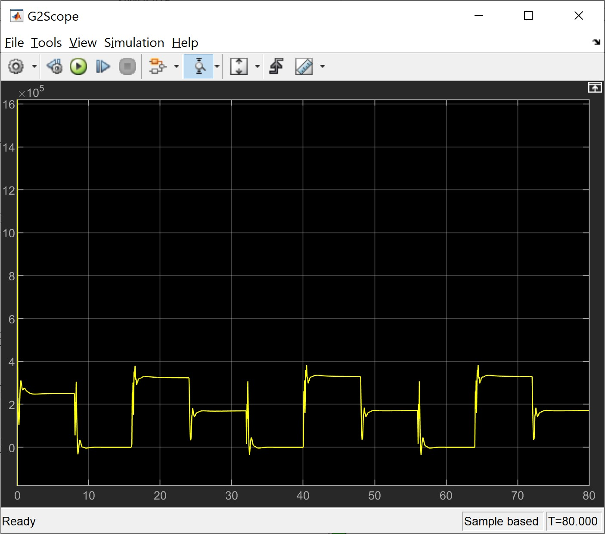
Generator 2

Slide 36
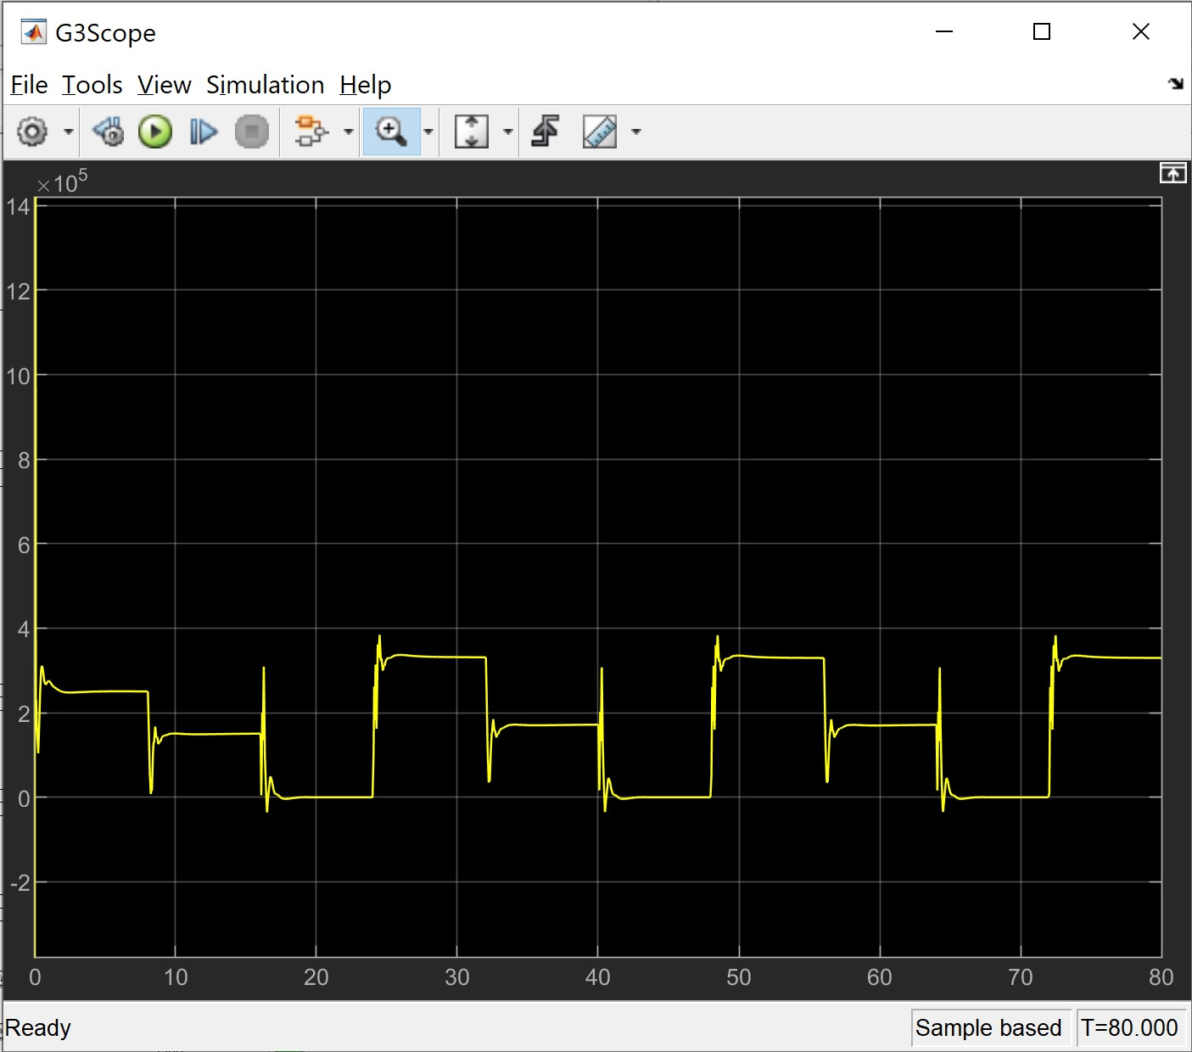
Generators 3

Slide 37
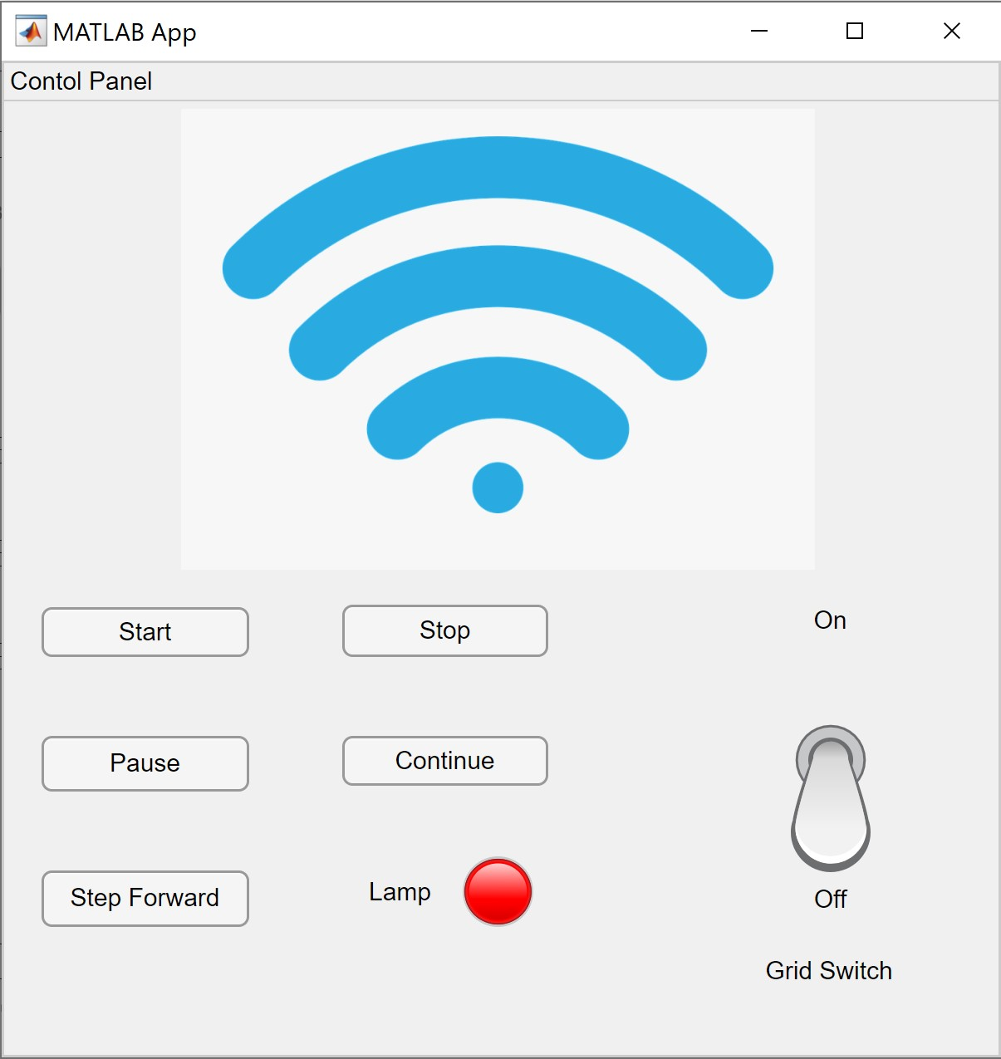
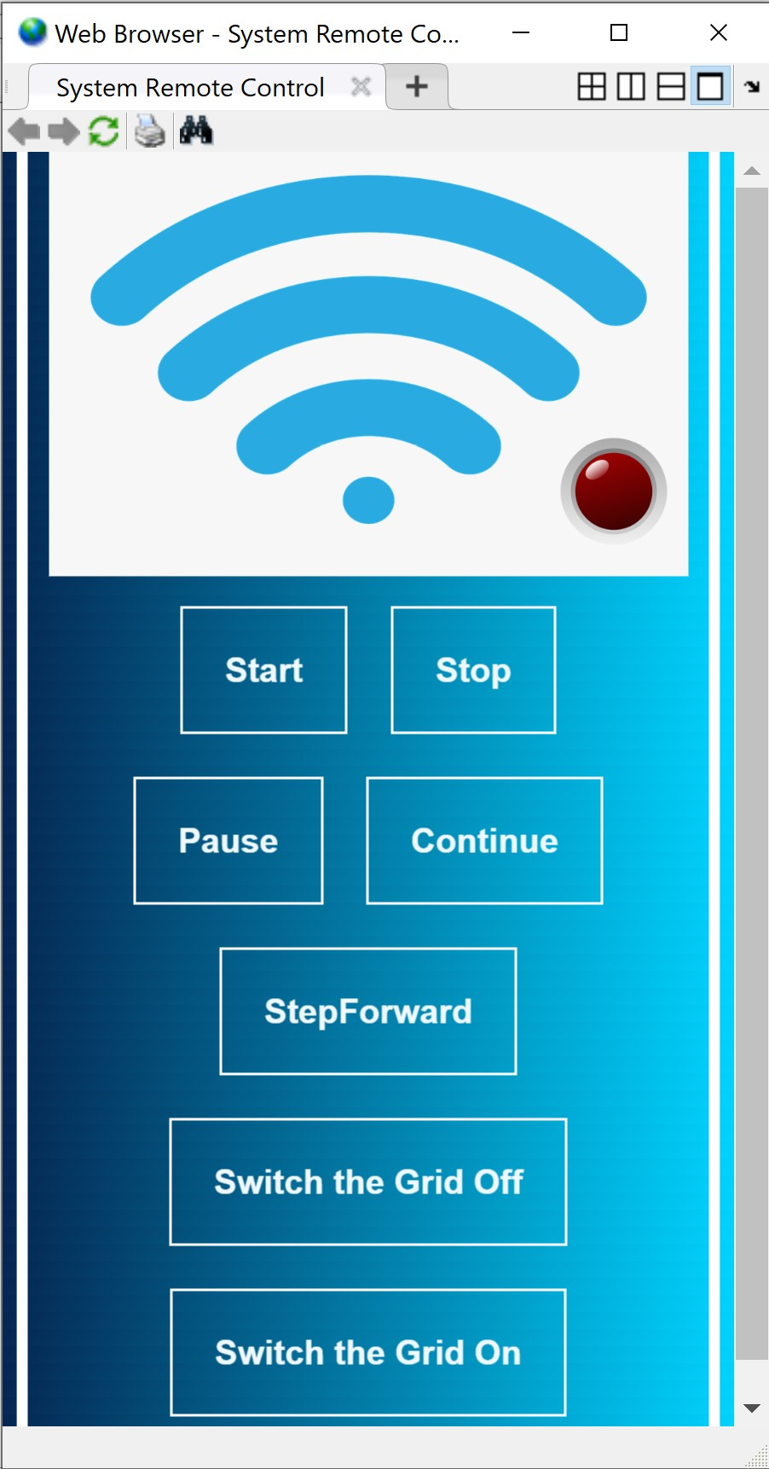
Remote Control and Control Panel

Slide 38
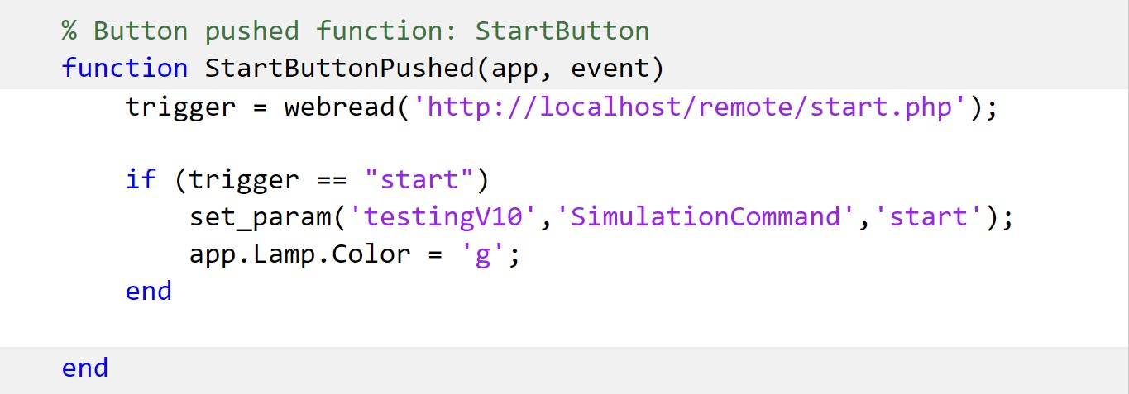
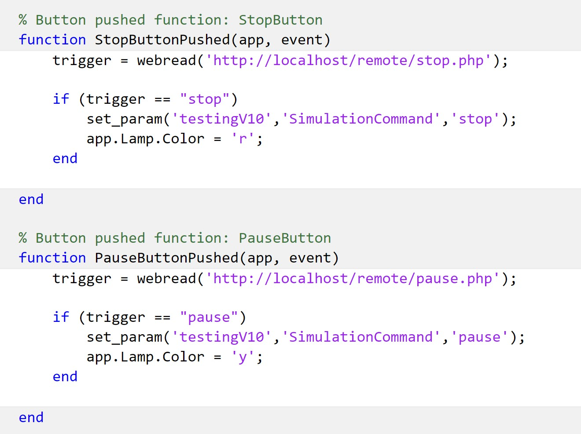
Application Coding

Slide 39
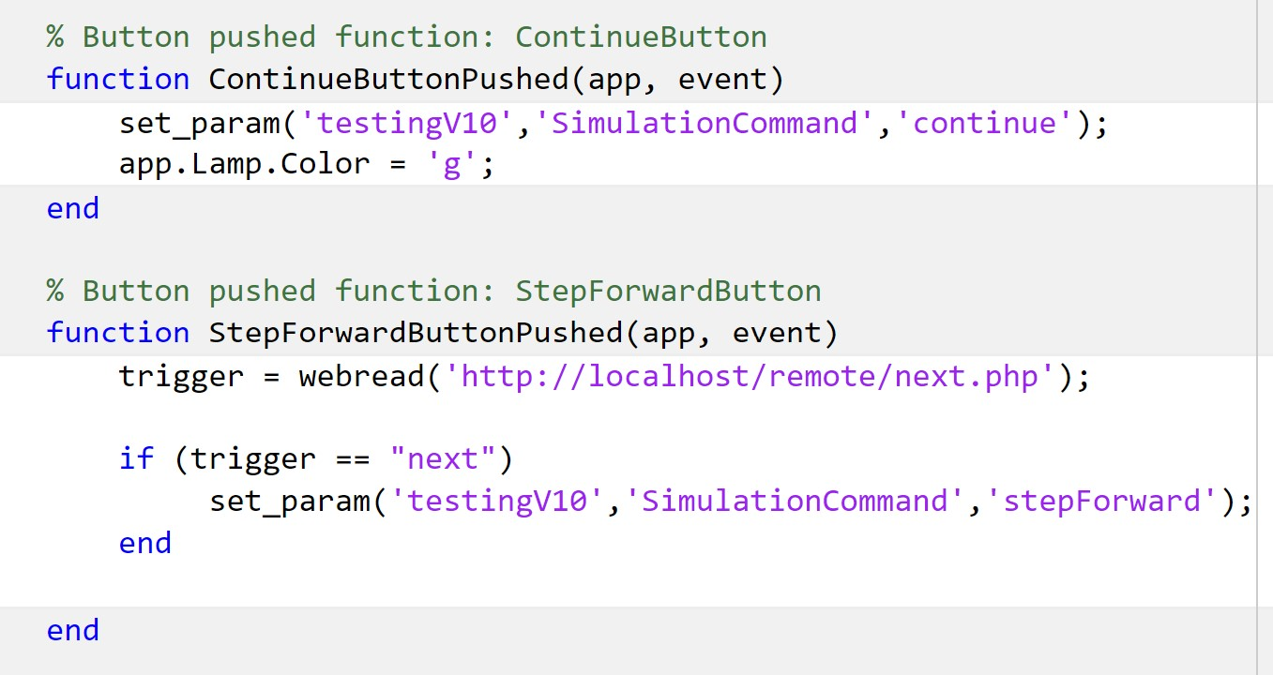
Coding

Slide 40
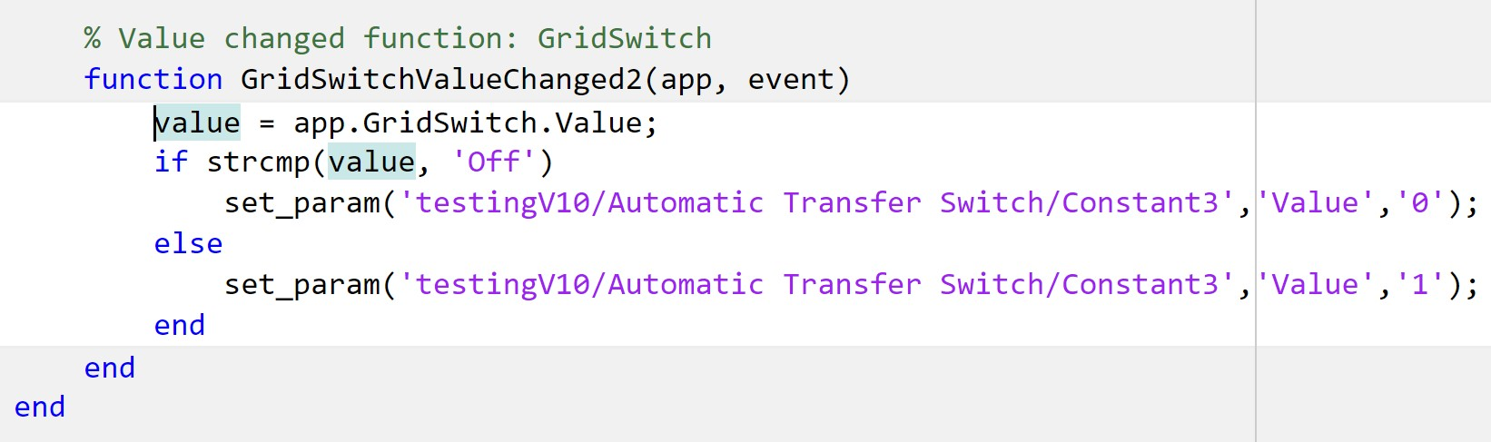
Coding

Slide 41

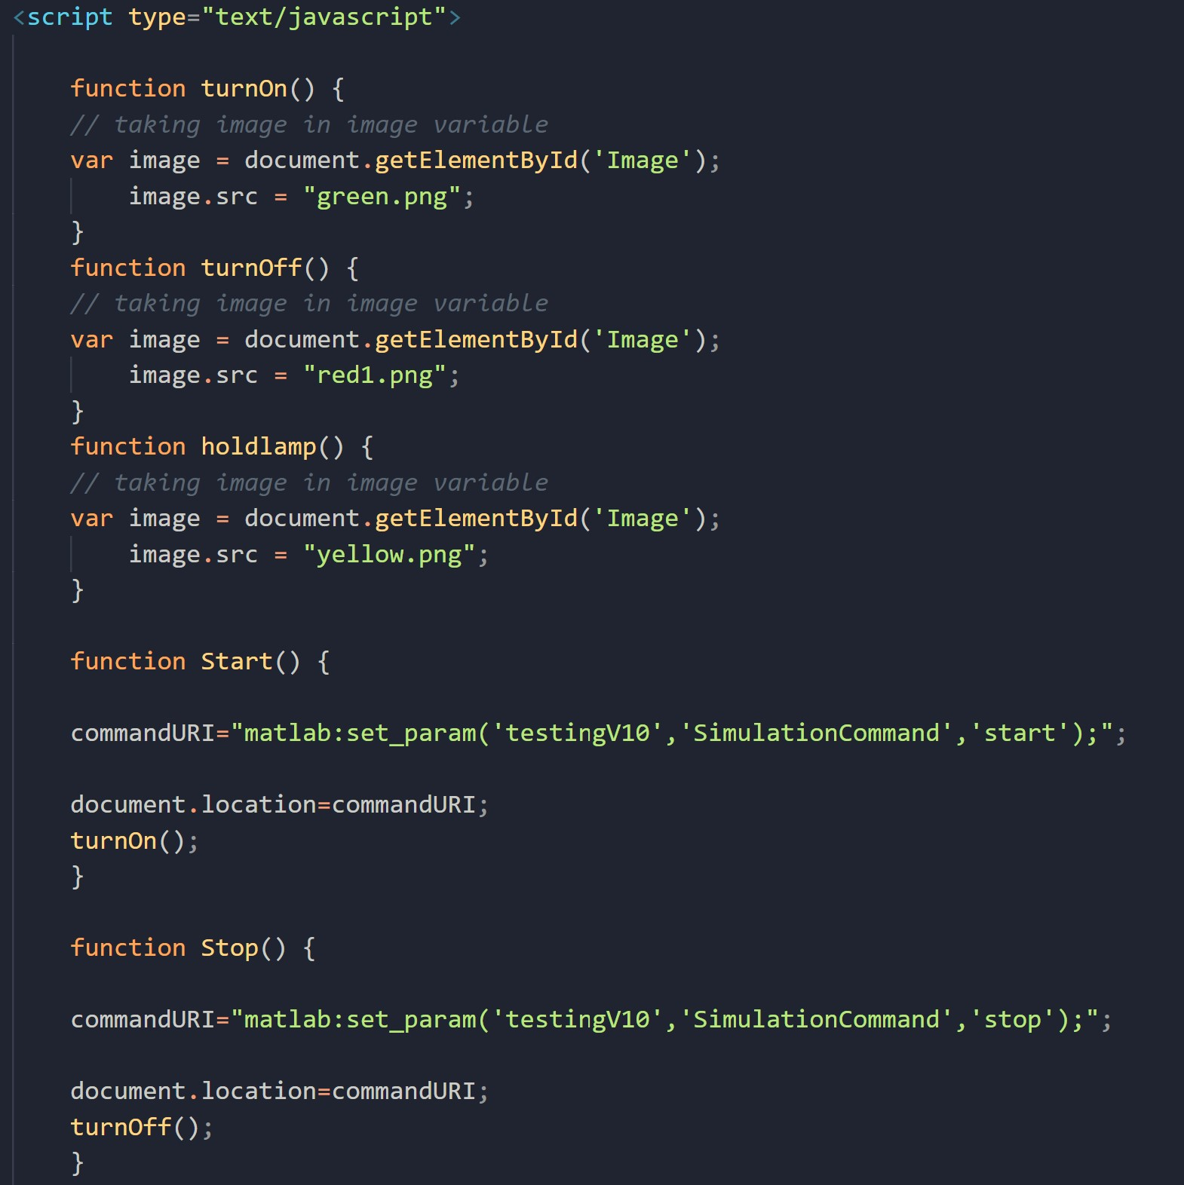

Remote control Via internet Link

Slide 42
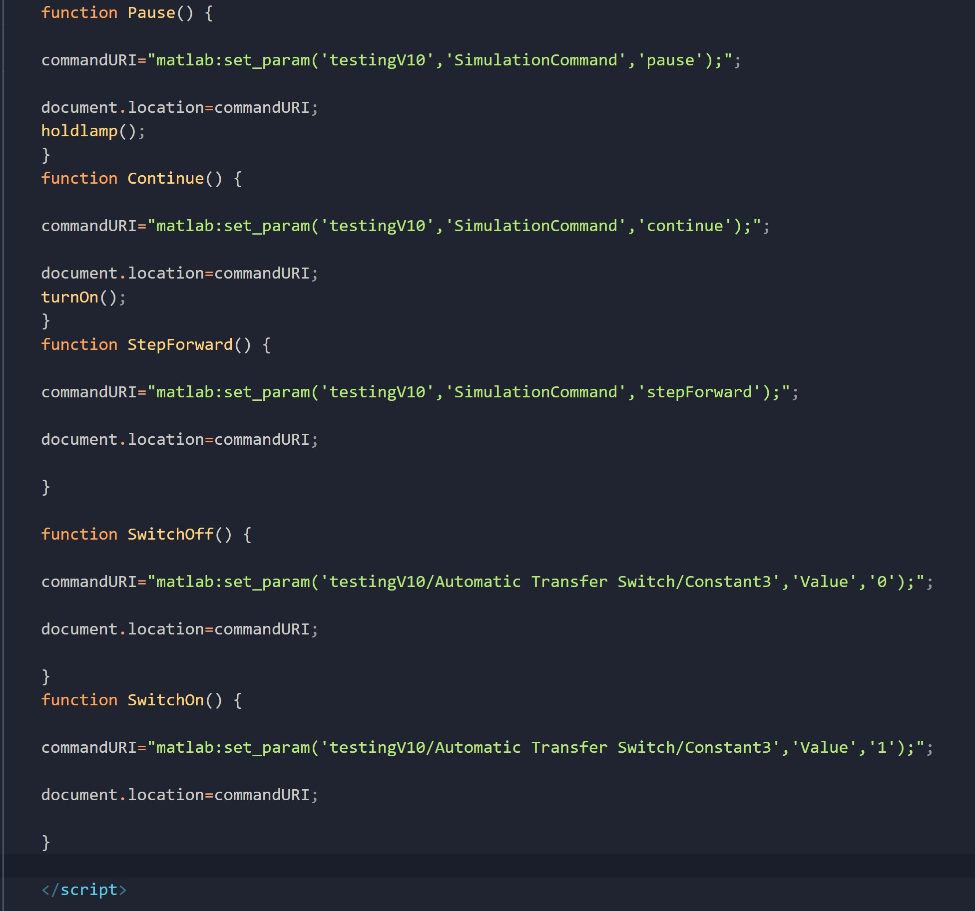
Remote control Via internet Link

Slide 43

Any Questions?

Slide 44
References
[1].”Three Dark Lamps Method” [online] Available: https://www.electronicshub.org/synchronization-of-generators / [Accessed: 5 jan 2020].
[2].”Synchronous Machine Implementation” [online] Available:https://ch.mathworks.com/help/physmod/sps/powersys/ref/synchronousmachine.html / [Accessed: 30 Dec 2020]
[3].”DEVELOPMENT of Diesel generators” [online] Available:https://www.sciencedirect.com/topics/engineering/diesel-generator / [Accessed: 6 Jun 2020].
[4].” Practical uses for generators” [online] Available:https://www.wpowerproducts.com/news/14-practical-uses-for-generators/[Accessed: 10 Jun 2020].

Slide 45


The End
Thank you

